Slide 1
Meeting Week 2 – Hybrid modeling Dual-Gantry
Last week summary
ASMPT meeting
  Key metric
Action point 1
…
Question 1
…
Outline ToDo next week
  Choose method → research for that
  Look into estimating plant / SI for that application
  Currently “too vague” to have a clear planning?

Slide 2
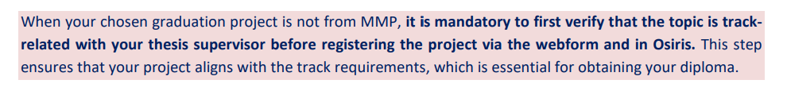
Last week summary
Research plan
  AI&ES relevance: Machine learning on dual-gantry system suffices
Study guide graduation project
  Track High-tech systems and robotics

Slide 3
ASMPT
ASMPT will provide:
  They will develop initial FP model in ~2 weeks
  Will enable me to automate data collection on the dual-gantry setup (not data experiment design)
Critical metric: settling error bounds
  For performance: initial movement reference tracking not as important
    Hysteresis is also applicable (= previous movements effects gantry initial movement)
Generic approach for obtaining data for experiments experiment
  Need to design “smart” tests rich in information and for unseen data validation
  Would be beneficial for them if its also applicable on other setups
Augmentation Kessels was effective on wire bonder → proposes orthogonality in limitations
(Look at mapping multiple nonlinearities, unseen flexible modes)

Slide 4
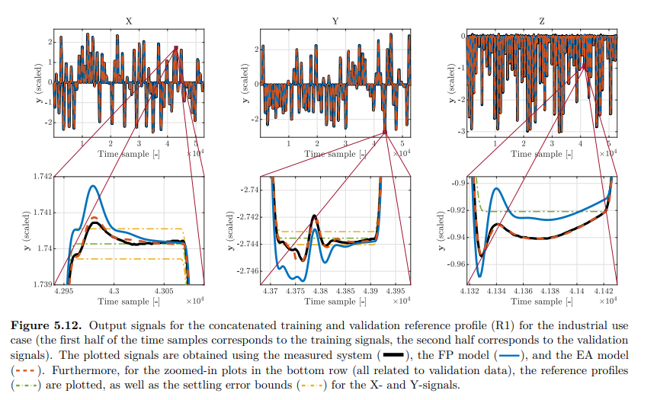
Settling error bound for Dual-Gantry
Bas Kessels paper
maximum allowed deviation of the system's output (position) from the reference trajectory after a specific amount of time has passed (the "settling time") / settling phase: the moments immediately after the reference profile reaches its target position.
FP often fails due to unmodeled dynamics
Goal of augmentation: reduce settling error bounds from FP model / telica settle times as baseline
Instead of RMSE → Target the Peaks; Settling time is determined by the last peak that exceeds the yellow limit line. Even with low RMSE peak could exceed
Feature selection Time Extremum (TE): magnitude and temporal location of local extrema (peaks and valleys) in the error signal; Kessels in application found not to be useful → instead weighted cost function for the peaks?
(Define start and end settling: reference trajectory velocity and acceleration 0 end when new movement begins)

Slide 5
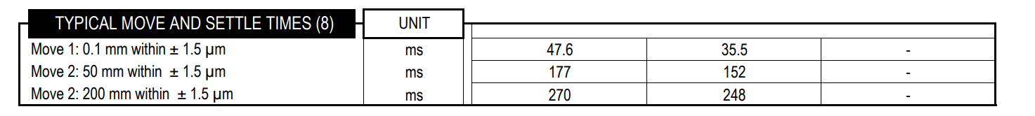
Settling error bound for Dual-Gantry
Bas Kessels paper
maximum allowed deviation of the system's output (position) from the reference trajectory after a specific amount of time has passed (the "settling time") / settling phase: the moments immediately after the reference profile reaches its target position.
FP often fails due to unmodeled dynamics
Goal of augmentation: reduce settling error bounds from FP model / telica settle times as baseline
Instead of RMSE → Target the Peaks; Settling time is determined by the last peak that exceeds the yellow limit line. Even with low RMSE peak could exceed
Feature selection Time Extremum (TE): magnitude and temporal location of local extrema (peaks and valleys) in the error signal; Kessels in application found not to be useful → instead weighted cost function for the peaks?
(Define start and end settling: reference trajectory velocity and acceleration 0 end when new movement begins)

Slide 6
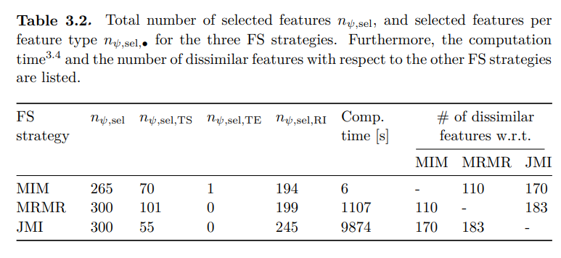
Settling error bound for Dual-Gantry
Bas Kessels paper
Instead of RMSE → Target the Peaks; Settling time is determined by the last peak that exceeds the yellow limit line. Even with low RMSE peak could exceed
Feature selection Time Extremum (TE) Limitation: Kessels showed that extracting local extrema features is often suboptimal for industrial systems due to noise sensitivity and low information density→ For dual-grantry, instead peak-weighted cost function for the peaks?
(Define start and end settling: reference trajectory velocity and acceleration 0 end when new movement begins)
Notes:
Kessels found that while TE features (magnitude and timing of peaks) are physically intuitive, they are often comparatively inaccurate in industrial applications because they are sensitive to measurement noise and contain low information density (sparsity) compared to using full time-samples or frequency-domain data
Real and Imaginary (RI) parts of the Fourier Transform were the most effective features.
Why they are good: Kessels notes that RI features are "relatively informative" and robust. Unlike Magnitude/Phase (MP) features, where the phase can look very similar for different parameter combinations
Time Sample (TS) features were the second most important group.
JMI Strategy MRMR Strategy MIM Strategy

Slide 7
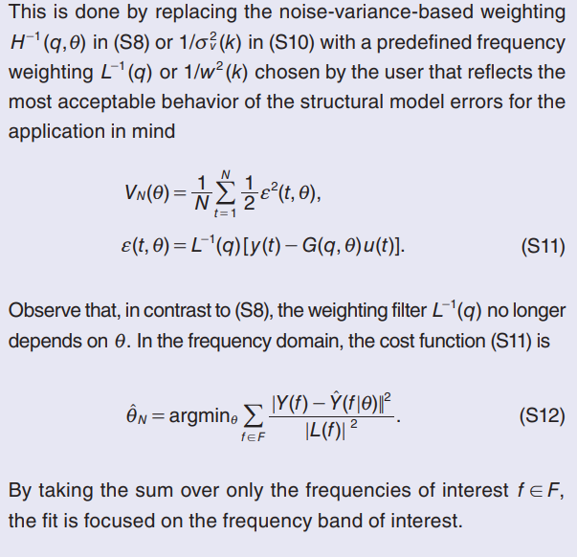
Region of interest & Targeting the peaks
Schoukens & Ljung
Wet-Clutch example for dual-gantry
  Design “spiky” position commands to make the response settling-dominated. Superimpose a multisine to identify local dynamics
Weighting function L(q): tells the optimizer where accuracy matters
  Acts as a pre-filter to the prediction error before computing the cost → result minimize a weighted (filtered) error
  Choose L to specify which frequencies require more accuracy
  Need to translate time-domain requirement (stay within ±1.5 µm) into a frequency domain instruction for the optimizer
Notes:
superimpose a multisine onto a spiky trajectory to create a "Rich Spiky Signal.“
Spike: take the specific trajectory you need (e.g., the rapid engagement profile or your gantry's stop-start motion). You create a band-limited approximation of this "spike" forces the system into the correct operating regime.
Multisine: add a small-amplitude, flat-spectrum multisine on top of it
Use a chosen weighting filter instead of a noise-based weighting tries to be optimal if your model structure is correct and noise assumptions hold.
Kessels Application
Imitating Operation (Input Design): Instead of abstract random noise, Kessels generates training data using "alternating smoothed step-up and step-down profiles." These explicitly mimic the reference profiles used during the machine's actual operation to capture relevant behavior
Implicit Filtering (Feature Selection): He replaces standard frequency weighting (L) with Feature Selection on "Frequency Bins of Interest" (FBoIs). The method extracts specific frequency ranges (e.g., near eigenfrequencies) and uses Mutual Information algorithms (like JMI) to discard noisy or irrelevant bins, effectively filtering the error signal
Regime Forcing (Closed-Loop): Similar to the "Wet-Clutch" high-pressure requirement, Kessels uses Closed-Loop Feedback during data generation. This forces the system to track the reference steps, ensuring the dataset is rich in the specific settling dynamics required for the high-precision application

Slide 8
Kessels Application
Imitating Operation (Input Design): Instead of abstract random noise, Kessels generates training data using "alternating smoothed step-up and step-down profiles." These explicitly mimic the reference profiles used during the machine's actual operation to capture relevant behavior
Implicit Filtering (Feature Selection): He replaces standard frequency weighting (L) with Feature Selection on "Frequency Bins of Interest" (FBoIs). The method extracts specific frequency ranges (e.g., near eigenfrequencies) and uses Mutual Information algorithms (like JMI) to discard noisy or irrelevant bins, effectively filtering the error signal
Regime Forcing (Closed-Loop): Similar to the "Wet-Clutch" high-pressure requirement, Kessels uses Closed-Loop Feedback during data generation. This forces the system to track the reference steps, ensuring the dataset is rich in the specific settling dynamics required for the high-precision application

Slide 9
Extension and Augmentation (EA)
Kessels
Goal: fix mismatch between theoretical First Principles (FP) model and the real physical system
Extension: introduce new state variables that capture unmodeled dynamics
  Subspace Encoder (NN) looks at past data and estimates hidden states
Augmenation: Physical model might have incorrect parameters (or simplified equations)
  EA adds RNNs directly into the force/accelerations equations of the physical model
Negation Problem: NN cancels out physical parameters; NN might take easy route and learn simple dynamics and not the nonlinearities
  Mentions for further research Orthogonality to improve on negation effect
Notes:
The EA Solution:
• New Variables: EA mathematically extends the state vector. If your model has 2 states [x,x˙], EA adds [z1​,z2​] to track the unmodeled vibrations
The Subspace Encoder: Since you cannot measure these new "hidden" vibration states directly with sensors, you use a Subspace Encoder. This is a Neural Network that looks at a window of past input/output data (history) to estimate what these hidden states are at the current moment
Dynamics: A Recurrent Neural Network (RNN) learns how these new states evolve over time (e.g., how the vibration decays
The EA Solution:
• Force Injection: EA augments the existing equations. It injects a "correction force" directly into the acceleration equation of the FP model
◦ Standard FP: a=Finput​/m
◦ Augmented: a=(Finput​/m)+RNNcorrection​

Slide 10
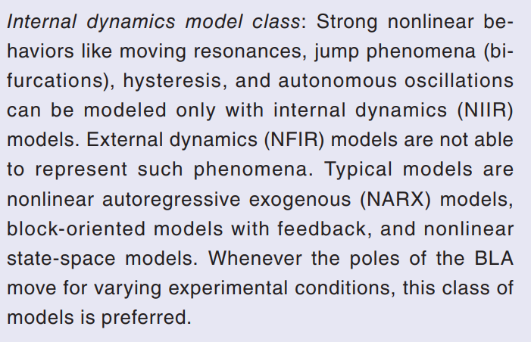
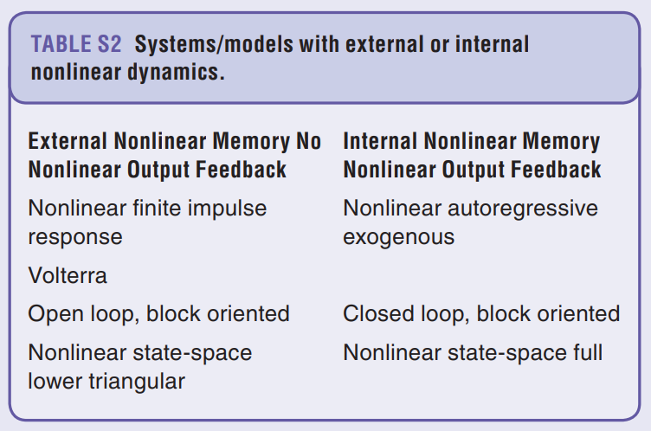
Orthogonality
Orthogonal by construction (ObC) requires input-output, realistic for the dual-gantry system?
Dual-gantry system has position-dependent stiffness → resonance frequencies move → state space
Notes:
Orthogonal by construction currently states that further research for state-space needs to be done
resonance frequencies = poles
Dual-gantry: position-dependent dynamics and cross-coupling between gantries
Definition of Internal Dynamics (NIIR): These models have a nonlinear feedback loop. The nonlinearity isn't just applied to the input (external); it is part of the system's internal memory loop.
When to Use Them: You must use this class of models if your system shows strong nonlinear behaviors like:
◦ Moving Resonances: The resonance frequency shifts as the operating point or excitation amplitude changes (crucial for dual-gantry).

Slide 11
Orthogonal Regularization (State-Space)
Add penalty term to the optimization cost function for predictions that look like rigid-body physics
Use simulated states generated by FP model to construct projection matrix → compatible with Nonlinear State-Space
Linearization point can be updated at each iteration using the current estimate
  Requires recomputing SVD and projection matrix every time the cost function is evaluated → computation expensive
  Only initialize projection matrix at the start of training with initial best guess estimate of the physical parameters → telica datasheets available
Notes:
Orthogonal Regularization for physical parameters vs prediction accuracy for the EA method
add a penalty term to the cost function. This penalizes the neural network if its output lies in the same mathematical subspace as the physical model's output.
• Why simulated? In "Orthogonal-by-Construction" methods for input-output models, you use past measured data to build the projection matrix. However, for a State-Space model (like your dual-gantry), the internal states (velocities, flexible modes) are often not fully measured.
The Method: use the simulated states (x^) generated by your First-Principles (FP) model to construct the Jacobian (sensitivity matrix). This allows you to apply orthogonality even to latent/hidden states, making it compatible with nonlinear state-space formulations where full state measurement is impossible.

Slide 12
LPV-LFR

Slide 13
Combining EA with Orthogonality
EA continuously updates physical parameters
Nominal approximation: Initialize SVD once to build projection matrix Π.
  Ideally we would update the SVD at every update step
Notes:
Why "EA continuously updates" is a problem for Orthogonality In standard "serial" grey-box modeling, you might fix the physical parameters and then train a network. But in your EA method, you are doing joint estimation—updating the mass/stiffness
• The Logic: Even though the datasheets aren't perfect (that's why you are updating them), they capture the general rigid-body behavior (mass/geometry) correctly.
• The Theoretical Ideal: Adaptive Orthogonality
◦ To ensure strict orthogonality, we should re-linearize the physical model around the current θ^ at every iteration.
◦ Drawback: This requires re-computing the Jacobian and performing an SVD at every step, which is computationally prohibitive
The Practical Solution: Nominal Approximation
◦ Method: We calculate the Jacobian and Projection Matrix (Π) once at the start, using the nominal parameters (θ0​) from the Telica datasheets

Slide 14
Nonlinear System Identification
Schoukens & Ljung, Kessels
OMNIPUS (OptiMized Nonlinear InPUt Signal): Instead of random noise, generates randomized step-like sequences
  Models better to unseen data
  OMNIPUS responsible for global movement. Combine with “Wet-Clutch Trick” for local excitation?
Selecting regime points for the dual-gantry system
  Need to select specific coordinates that represent extreme cases
  Automate with HILOMOT (HIerarchical LOcal MOdel Tree) algorithm
Notes:
1. OMNIPUS (OptiMized Nonlinear InPUt Signal)
• What it is: Instead of using standard white noise (which concentrates energy around zero), OMNIPUS generates randomized step-like sequences.
• Why use it for the Gantry:
◦ Constraint Handling: It respects physical limits (amplitude and gradients) while maximizing coverage of the operating space.
2. Combining OMNIPUS with the "Wet-Clutch Trick"
You should explain this as a "Global vs. Local" identification strategy.
• OMNIPUS (Global Position): Use the randomized steps of OMNIPUS to move the gantry to specific positions (x,y) within the workspace. This handles the position-dependent nature of the system (moving to where the stiffness changes).
• Wet-Clutch Trick (Local Dynamics): Once the OMNIPUS signal holds the gantry at a specific "step" (regime point), you superimpose a small-amplitude Multisine.
◦ Purpose: This excites the local flexible modes (resonances) at that specific position.
◦ Result: You get a high-fidelity snapshot of the frequency response (stiffness/damping) at every critical position in the workspace, solving the "moving resonance" problem .
• The Solution: HILOMOT is an algorithm that automatically partitions the input space.
Because cant visit every coordinate
• How it works:
1. Start with a single global linear model for the whole gantry workspace.
2. Calculate the local error across the workspace.
3. Split the space: The algorithm automatically splits the input space (the XY positions) into two halves at the location where the local error is worst.
4. Repeat: It continues to split these regions into smaller "leaves" (local models) until the error is acceptable everywhere [Source 0, 87].
• Why for Gantry: This is ideal for position-dependent stiffness because it will automatically place more regime points in areas where the stiffness changes rapidly (likely near the center of the travel range) and fewer points where behavior is linear/consistent (near the supports) [Source 0, 87].

